Slide 1
Web Programming 1
Introduction to Angular, Part 3
Services, Dependency Injection

Slide 2
Favourite Movie Application
Create a new angular application called ‘movie-list’
ng new movie-list
Within app.component.ts create an array of your favourite movies
The array will have id, title, year & director
Have at least 3 movies (following slide)
Within app.component.html
add *ngFor loop to display movie details (following slide +1)
Run your application
ng serve

Slide 3
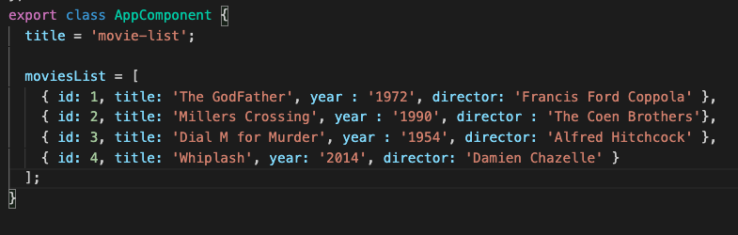
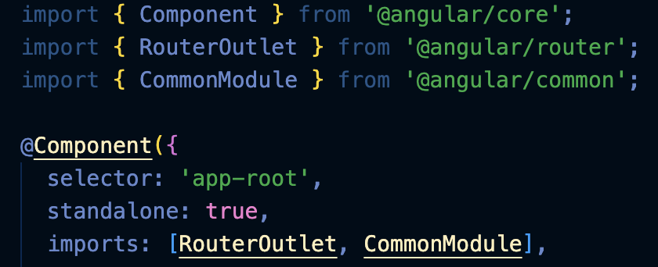
app.component.ts
Syntax for multidimensional array
* remember, we still have to import CommonModule…

Slide 4
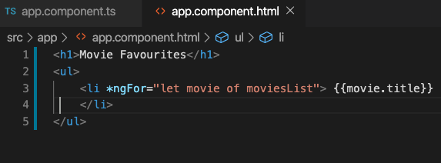

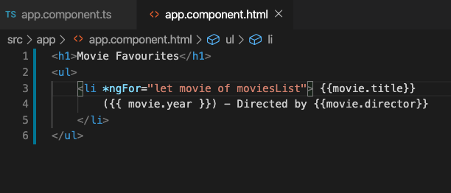

app.component.html

Slide 5
Improvements
This approach might work now but it is not exactly optimal!
Our data (movie array) is contained within our app.component.ts file – this is really not the place for it!
A service essentially lets us have a reusable task
We will separate our data from the view component

Slide 6
Separation of Responsibilities
The main reason for choosing a framework like Angular is to ensure that code is well implemented, easy to follow, maintainable and testable.
With the single responsibility principle – a component should only be responsible for views
Angular provides this structured framework – but you still need to implement appropriately!
Reusable tasks are implemented as services and we add them through dependency injection.

Slide 7
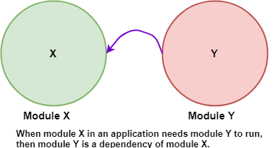
What is Dependency Injection?

Slide 8
What is Dependency Injection?
Dependency Injection (DI) is a way to create objects that depend on the other objects. An object receives another object it depends on.
Dependency injection is an important application design pattern.
Using DI, we can move the creation and binding of the dependant objects outside of the class that depends on them
It helps to make our apps flexible, efficient, and robust. For example we can ‘mock’ objects – this is an object that simulates the response of a real object.

Slide 9
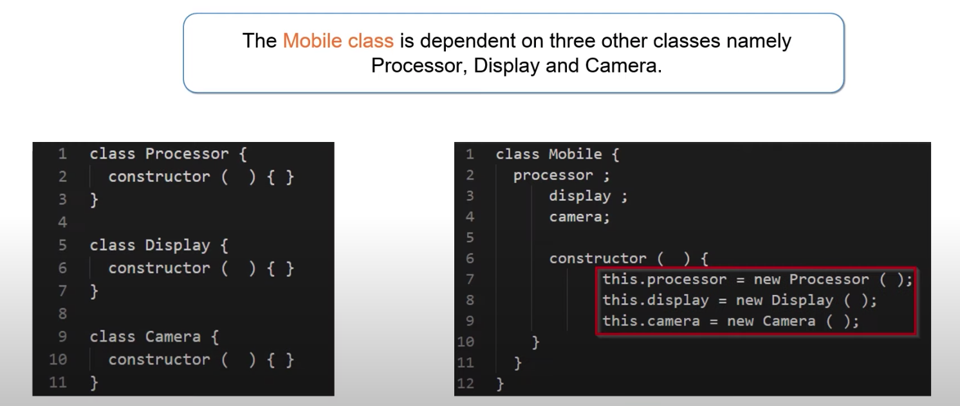

Slide 10
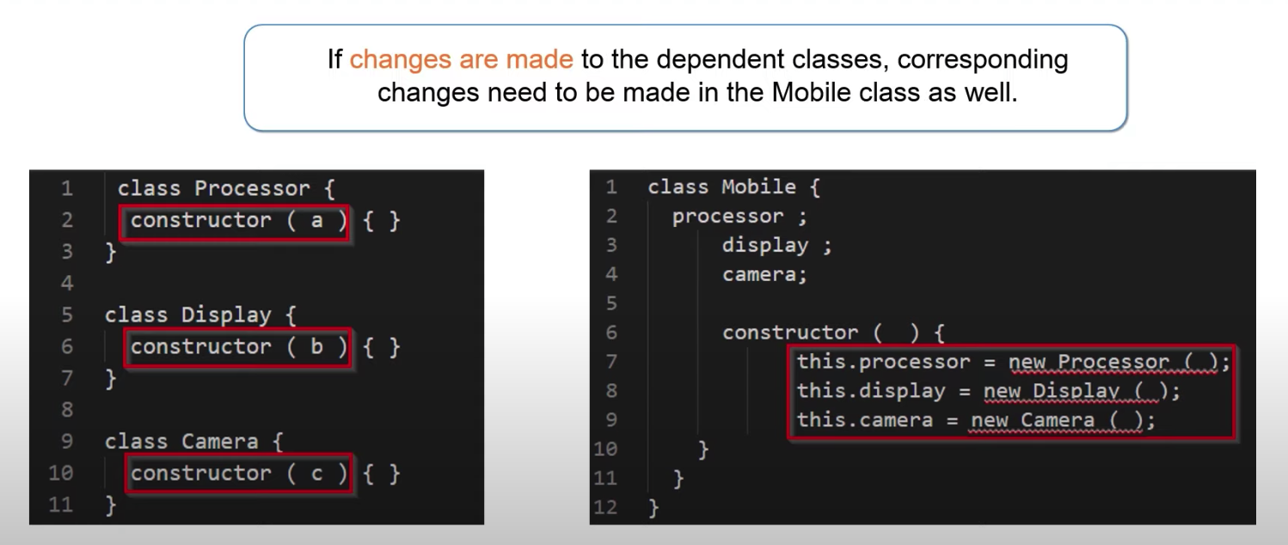

Slide 11
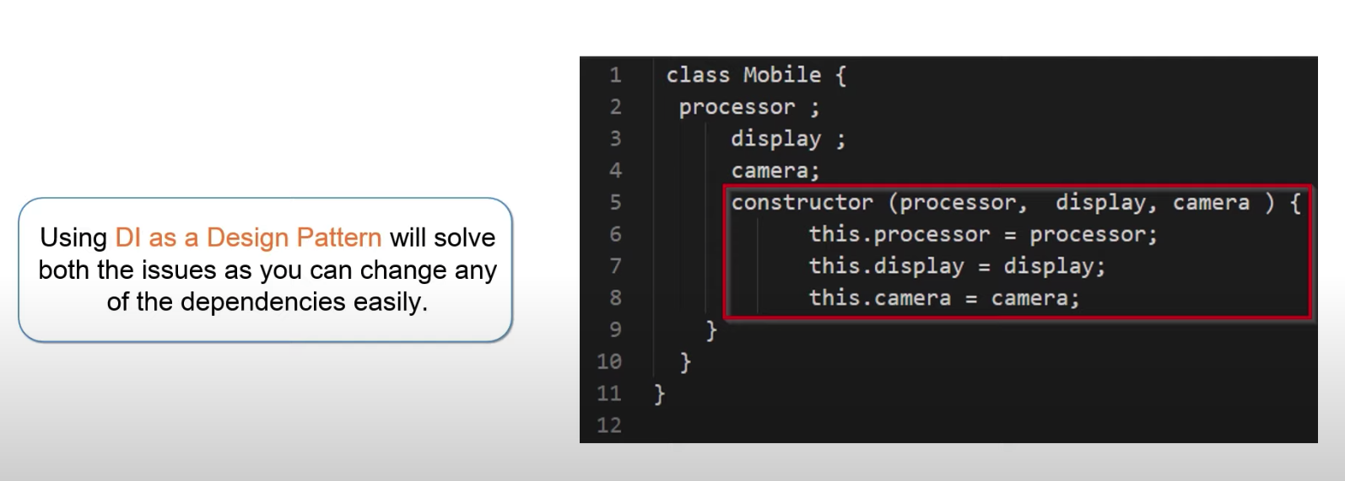

Slide 12
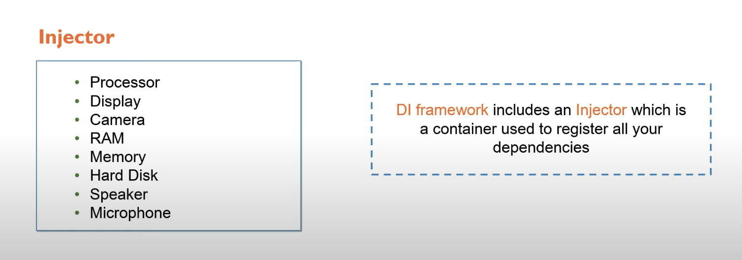

Slide 13
Dependency Injection and Angular
Angular has its own DI framework, which is typically used in the design of Angular applications to increase their efficiency and modularity.
Dependencies are services or objects that a class needs to perform its function. DI is a coding pattern in which a class asks for dependencies from external sources rather than creating them itself.
In Angular, the DI framework provides declared dependencies to a class when that class is instantiated.

Slide 14
Services & Dependency Injection
In Angular, a service is an instance of a class that can be made available to any part of your application using Angulars DI system
Services are the place where you share data between parts of your application.
In out movie example, we would generate a new movie service
Go to terminal window
ng generate service movie
This will generate the following file automatically for us :
movie.service.ts (we will adjust this file to contain our movie array)

Slide 15
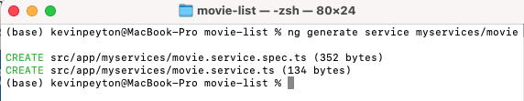
Creating a new service in Angular ng generate service <name>
Let’s use the example of our movies. We have information associated with movies – title, director and year – we want to create a service for this
ng generate service myservices/movie
We might have a number of services in our app – so we could bundle them all together in one location – “myservices”
The service name is “movie” (creates movie.service.ts)
We can use ng generate to create components and services
You can locate all of your services in one directory – makes application well organised
Service name is movie

Slide 16
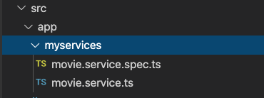
movie.service.ts (our service file)
The myservices directory created and populated with the movie.service.ts file

Slide 17
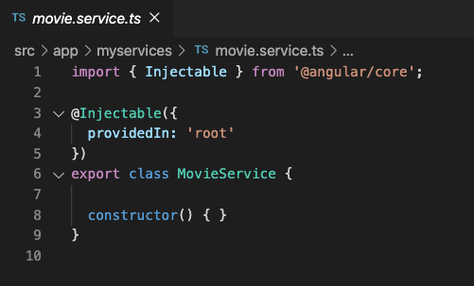
movie.service.ts (our service file)
The @Injectable() is essential syntax in every Angular service definition
The @Injectable() decorator marks the class as a service that can be provided and injected as a dependency
With ‘root’ specified in providedIn we can access the service across our whole application – this is the default

Slide 18
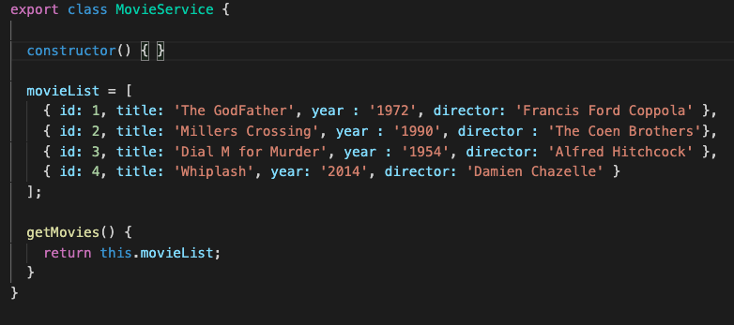
movie.service.ts (our service file)
The MovieService class that has been created provides our service
The rest of the movie.service.ts file contains the definition of our movie array – we have disentangled data from our view
Furthermore with getMovies() – we return the list of movies to our component – this is really mock data – eventually we will get this from an API!!

Slide 19
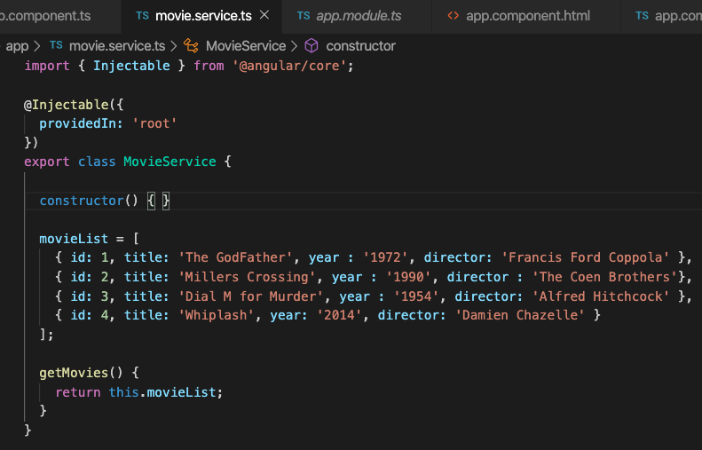
Specifying ‘root’ allows us to provide this
service in AppModule
We also create a method called getMovies() – this
will return data to app.component.ts

Slide 20
So what’s next?
We have our movie service setup – it’s using mock data but eventually we will get this from an API
We now need to access our services from our component – from app.component.ts
We will do the following in the component
Will need an array to hold the data
Make the service file available to the component (import)
Instantiate the service in the component (via constructor)
Finally retrieve the data (via the initialization of the component)

Slide 21
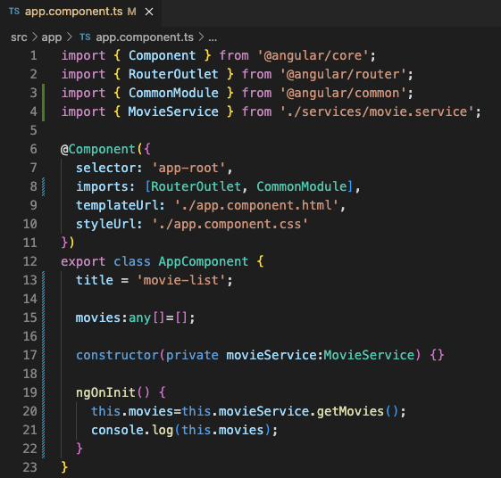
Within app.component.ts we first need to
import reference to our movie service
Declare an array called movies
Declare the movieService in the constructor
Of AppComponent. This is where Dependency
Injection takes place
Finally add this code within ngOnInit()

Slide 22
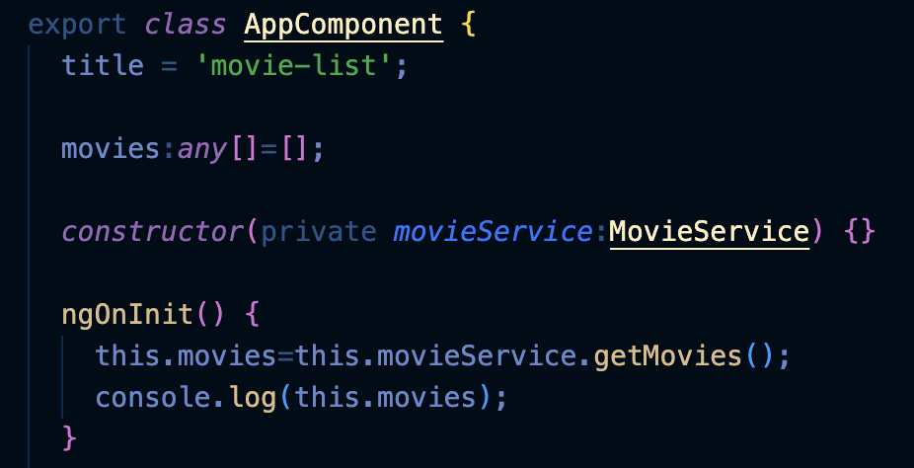
Injecting service into app.component.html
In our class we define movies of type array;
You can tell Angular to inject a dependency in a component's constructor by specifying a constructor parameter with the dependency type – in this case movieService of type MovieService
You should use constructor() to setup Dependency Injection and not much else. constructor() is instantiation of the class

Slide 23
Injecting service into app.component.html
Finally within ngOnInit we instantiate out movies array with data returned from service
ngOnInit only happens after the constructor() is ready. This means if we had any changes to be made to the data – we could do it here

Slide 24
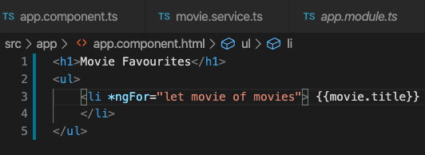
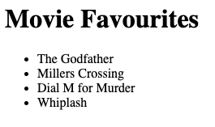
Finally we want to display our data
Within app.component.html we reference the movies array
Our data has been provided through dependency injection

